Slide 1
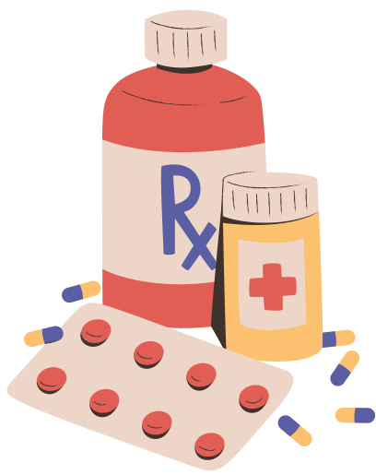


Automatic medicine reminder
Kratika (leader), Krish, Shikha Rawat, Hridyanshu singh
Under the supervision of
internal: Ms. archana goyal
external:
school of engineering and technology

Slide 2
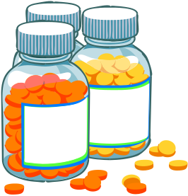


Introduction:
Medication non-adherence is a major health issue, especially among elderly individuals, chronic patients, and busy professionals. Forgetting to take medicines on time can lead to serious health complications and ineffective treatment.
An app-based automatic medicine reminder system helps users by providing timely alerts, dose tracking, and caregiver notifications to ensure proper medication adherence. With features like smart notifications, AI-based scheduling, and IoT integration, this system enhances healthcare efficiency and patient well-being. 🚀💊

Slide 3

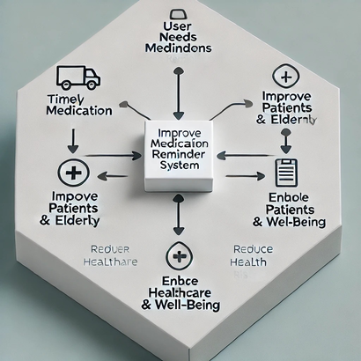
Project Overview: App-Based Automatic Medicine Reminder System
Objective:
To develop an app-based system that helps users take their medicines on time through automated reminders, tracking, and caregiver notifications, ensuring better medication adherence.

Slide 4


Key Features:
Timely Alerts – Push notifications, SMS, or voice reminders for scheduled medicines.
medication Tracking – Users can confirm, snooze, or skip doses.
Caregiver Notifications – Alerts family members if a dose is missed.
User-Friendly UI – Simple interface for elderly and non-tech users.
AI & Smart Suggestions – Future integration for personalized schedules.
IoT Integration (Optional) – Smart pill dispensers or smartwatch alerts.

Slide 5


Problem Gaps in Automatic Medicine Reminder System
No Confirmation of Medicine Intake – Users may dismiss reminders without taking the dose.
Limited Caregiver Alerts – Many apps lack real-time notifications for family or doctors.
Poor Elderly Accessibility – Seniors may struggle with complex interfaces.
No Smart Monitoring – Lack of IoT-based tracking like smart pill dispensers.
Ignored Notifications – Simple alerts may not be enough; users tend to skip them. Internet Dependency – Cloud-based systems fail in areas with poor connectivity.
Data Security Risks – Storing medical records requires strong privacy protection.

Slide 6


Methdology:
Problem Identification – Analyzing missed medications & target users.
System Design & Planning – Selecting tech stack, UI/UX design, and features.
Development – Building backend (database, APIs), frontend (UI), and notification system.
Testing & Debugging – Unit, system, and user testing for reliability.
Deployment & Maintenance – Launching the app, updates, and future AI/IoT integrations.
Ensures timely reminders, better adherence, remote monitoring, and improved healthcare

Slide 7



Expected outcome:
Better medication adherence through timely reminders.
Reduced health risks for patients with chronic conditions.
Enhanced caregiver support with remote monitoring features.
Scalable solution with future IoT and AI integrations

Slide 8

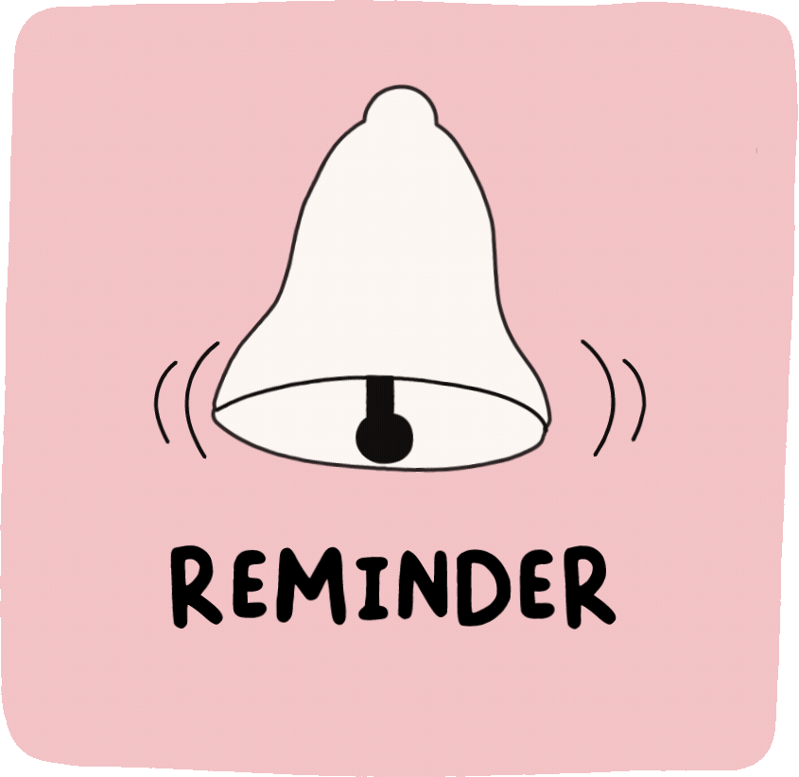

Applications:
Healthcare & Hospitals – Helps patients follow prescriptions, reducing hospital readmissions.
Elderly Care – Assists seniors in taking medications on time, reducing health risks.
Chronic Disease Management – Essential for diabetes, hypertension, and heart patients.
Smart Wearable Integration – Can be linked with smartwatches for reminders & tracking.
Home Healthcare – Beneficial for individuals managing their health independently.
Pharmacies & Telemedicine – Can integrate with pharmacies for automated refill reminders.
IoT & AI in Medicine – Future applications in smart pill dispensers & AI-based dose optimization.

Slide 9


challenges:
User Compliance – Users may ignore or dismiss reminders, reducing effectiveness.
Accurate Dose Tracking – Difficult to ensure whether the user actually took the medicine.
Technical Issues – App crashes, notification failures, or device compatibility problems.
Elderly Accessibility – Seniors may struggle with app usage due to low tech literacy.
Caregiver Integration – Implementing real-time alerts for family or doctors can be complex.
Data Privacy & Security – Ensuring user health data is securely stored and protected.
Internet Dependency – Cloud-based reminders may fail in areas with poor connectivity.:

Slide 10



limitations:
No Physical Verification – App can't physically confirm if the medicine is consumed.
Battery & Power Issues – Device shutdowns or low battery can disrupt reminders.
Language & Regional Barriers – Limited accessibility for non-tech-savvy or non-English users.
Limited IoT Integration – Without smart pill dispensers, manual confirmation is needed.

Slide 11
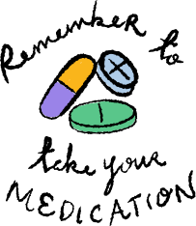
conclusion:
The App-Based Automatic Medicine Reminder System is a smart healthcare solution designed to improve medication adherence by providing timely reminders, tracking doses, and notifying caregivers. It addresses the issue of missed medications, especially for elderly individuals and chronic patients, reducing health risks and improving treatment outcomes.
While current systems face challenges like user compliance, IoT integration, and data security, future enhancements with AI-based recommendations and smart pill dispensers can make the system more effective. This project contributes to better healthcare management, patient safety, and overall well-being.

Slide 12



references:
Popular apps like Medisafe, MyTherapy, and Pill Reminder
Studies on IoT in healthcare & smart pill dispensers.
AI & IoT in smart healthcare solutions.

Slide 13

Q&A:
questions??

